Slide 1
UNIT-IV SYLLABUS Functions: Introduction – using functions – Function declaration/ prototype – Function definition – function call – return statement – Passing parameters – Scope of variables – Storage Classes – Recursive functions. Structure, Union, and Enumerated Data Types: Introduction – Nested Structures – Arrays of Structures – Structures and Functions– Union – Arrays of Unions Variables – Unions inside Structures – Enumerated Data Types.

Slide 2
NESTED STRUCTURES:
A structure can be embedded within another structure. In other words when a structure is declared and processed with in another structure then it is called nested structure or structures within structures.

Slide 3
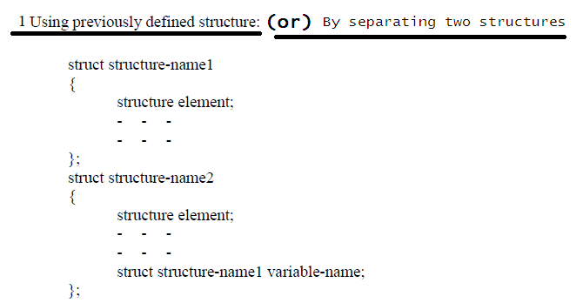
Structures can be nested in two ways.

Slide 4
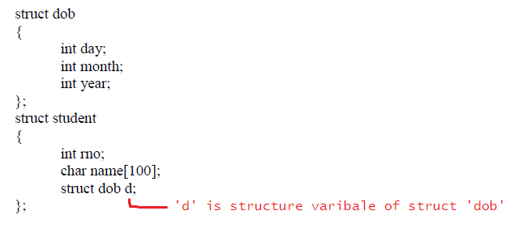
Example

Slide 5
Write a c program for nested structure concept

Slide 6
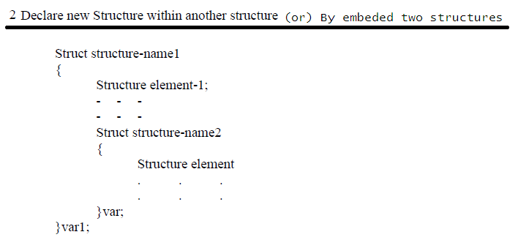

Slide 7
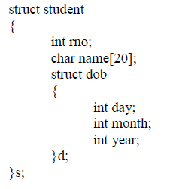
Example
The inner structure elements can be linked with the outer structure variable by dot operator. This can be represented as
Outer-variable . inner-variable .inner-element;

Slide 8
Write a c program for nested structure concept

Slide 9
STRUCTURES AND FUNCTIONS
The C Programming allows us to pass the structures as the function parameters.
We can pass the C structures to functions in 3 ways:
Passing each item of the structure as a function argument. It is similar to passing normal values as arguments.
Pass the whole structure as a value.
We can also Pass the address of the structure (pass by reference).

Slide 10
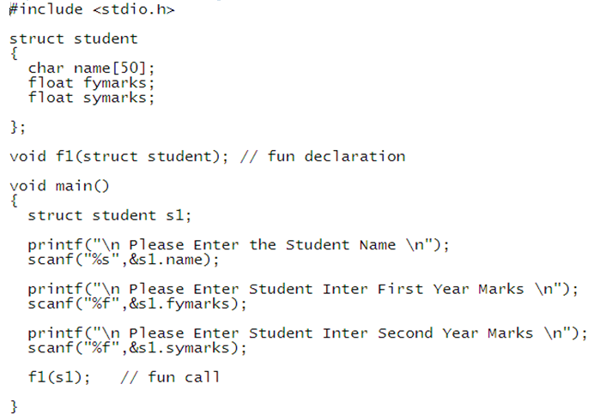
Example

Slide 11
